Slide 1
Object Detection with R-CNN
Jason Ligon
Daniel Kim

Slide 2
BACKGROUND & MOTIVATION
Object Detection - process of finding instances of real-world objects or people in images or videos
Image retrieval
Security
Surveillance
Automated vehicle system
Classic problem in computer vision, but very important
CNN is currently the best solution for object detection
Notes:
Talk briefly about our research in detection

Slide 3
BACKGROUND & MOTIVATION
Single object detection
Green traffic light
Covered different challenges faced in detection
Illumination variation
Scale variation
Traffic lights with different colors (i.e. red light, yellow)
Person detection presented more challenges

Slide 4
CIFAR-10
Consists of 32x32 colour images in 10 classes
6,000 images per class
5,000 training images
1,000 test images
Test batch contains randomly selected images from each class
Training batch contains remaining images in random order
Some training batches may contain more images from one class than another

Slide 5
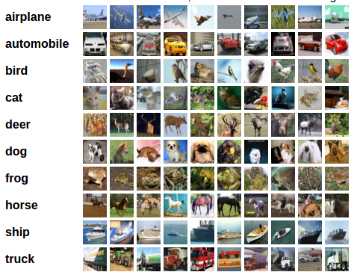
CIFAR-10

Slide 6
Multiple Object Tracking (MOT) Dataset
Aims to aid in multiple target tracking evaluation
Consists of multiple sets of captured video out in public space
MOT16 Dataset
7 video sequences of both training and test data
Filmed in unconstrained outdoor locations with both static and moving cameras
Ranging from 600 to 1050 still images

Slide 7
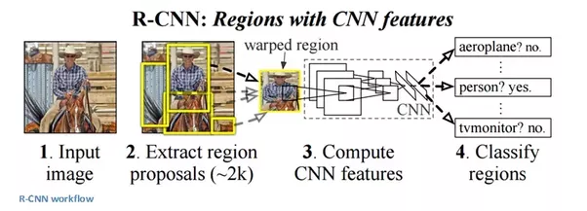
R-CNN (Region-based CNN)
R-CNN - object detection framework, which uses a convolutional neural network to classify image regions within an image
Only process regions that are likely to contain an object
Reduces the computational cost when running a CNN

Slide 8
TRANSFER LEARNING
Transfer learning workflow
Transfer learning - network pre-trained on a large collection of images such as CIFAR
Used as a starting point to solve a new classification or detection task
Advantage
Pre-trained network already has a rich set of image features applicable to wide range of image detection tasks
Reduces the number of images required for training
Transferable to new task by fine-tuning the network
Small adjustment to the weights such as feature representations for the original task are adjusted to support new tasks

Slide 9
METHODS
Build custom convolutional neural network in MATLAB
Pre-train normal CNN with CIFAR-10 dataset
Use pretrained network to create a R-CNN and train for traffic light detection with MOT16 dataset
Predefined ROI labels used for training
Test network with test data of corresponding MOT16 video sequence
Outputs a drawn ROI around detected object in test image

Slide 10
IMPLEMENTATION
Language: MATLAB
Version: R2016b
Framework (for neural networks): Computer Vision System Toolbox and Neural Network Toolbox
Environment: Ubuntu 16.04 & Windows 10

Slide 11
NETWORK ARCHITECTURE
Beginning layer is composed of input layer
3 x middle layer groups consist of:
convolutional layer, ReLU layer, max pooling layer
Final layers consists of: fully connected layer, ReLU layer, softmax layer, classification layer
2 x fully connected layers
Network parameters:
5x5 filter size, with 40 filters
0.001 learning rate

Slide 12
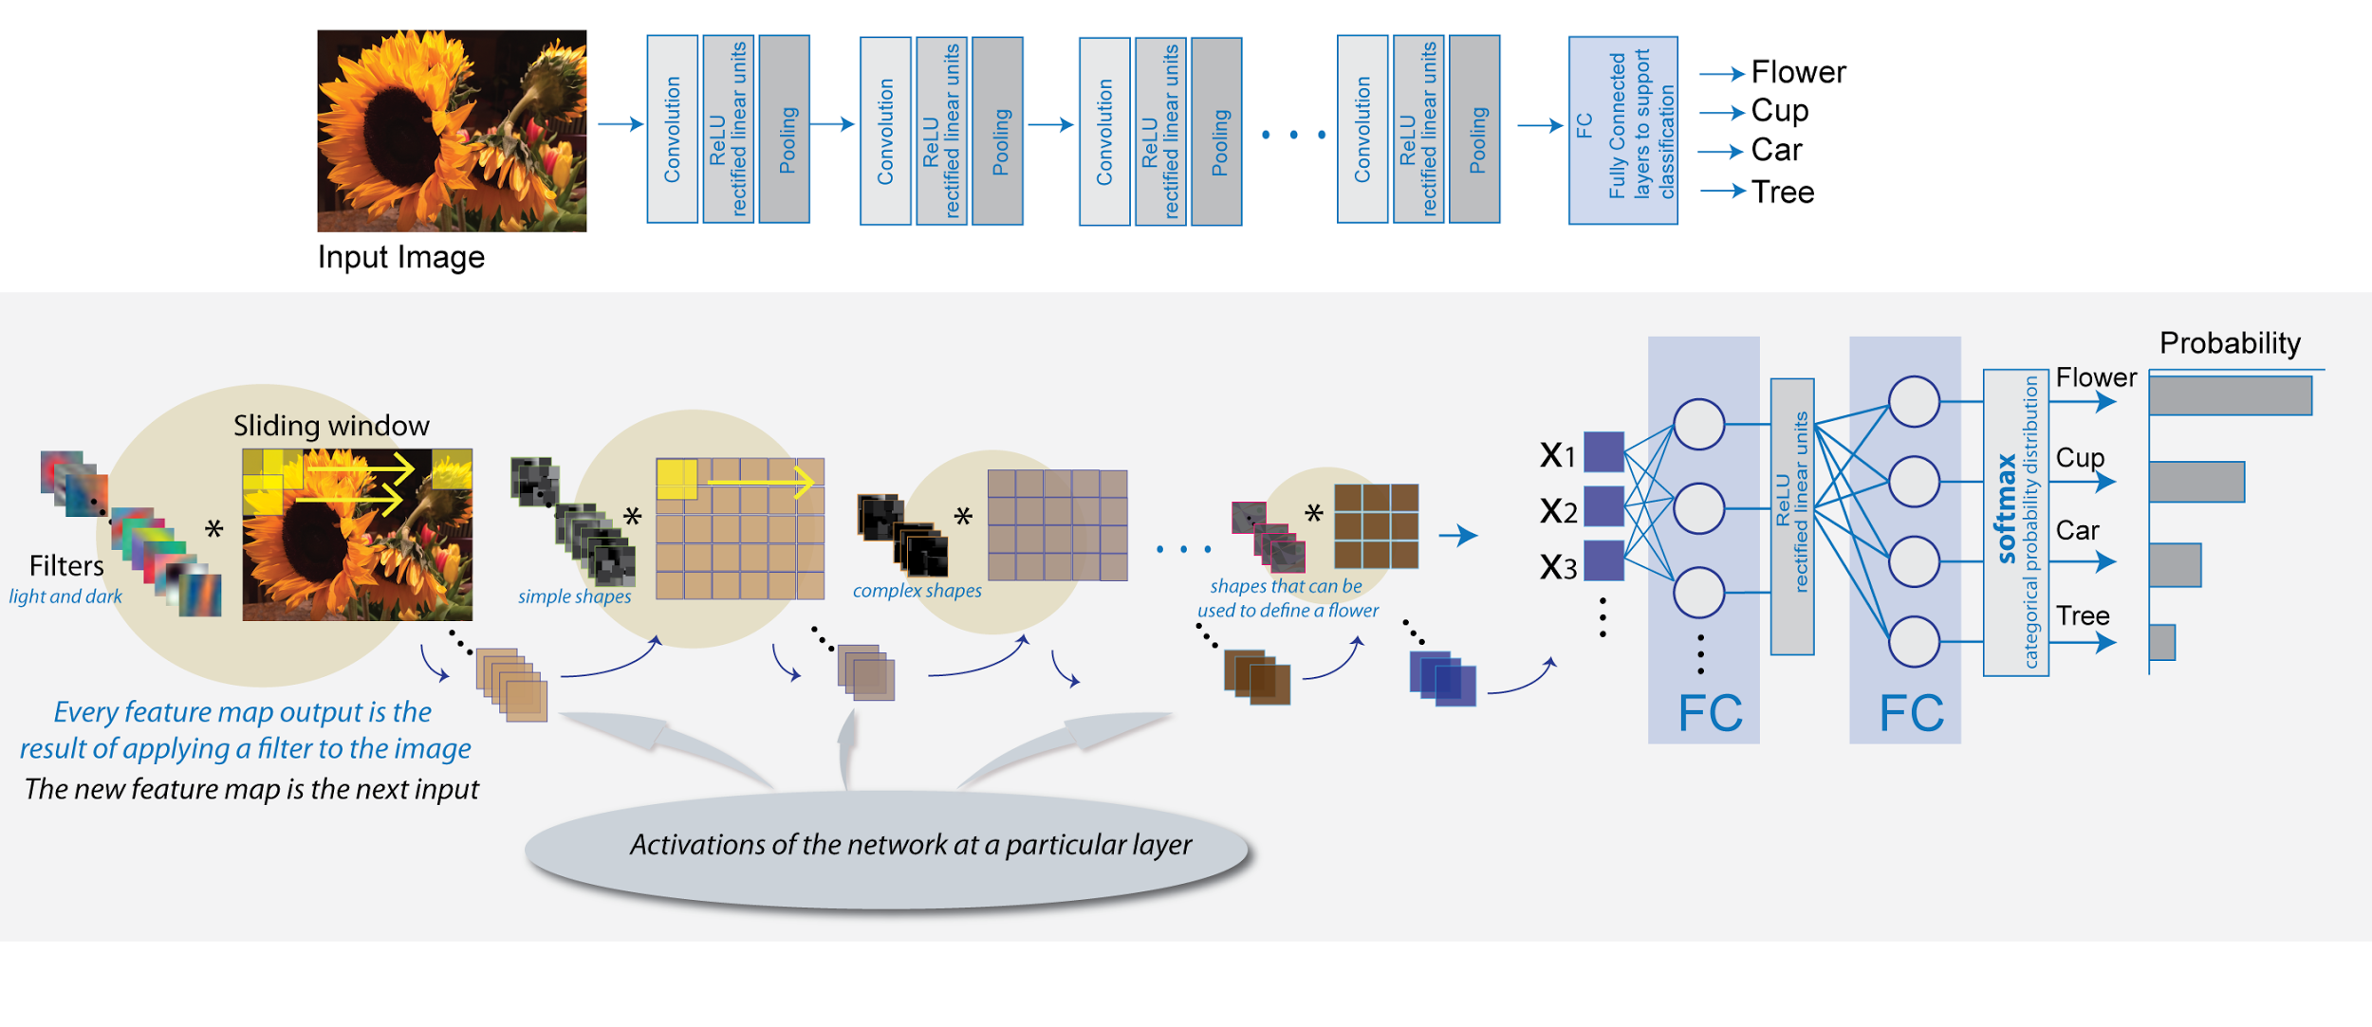

Slide 13
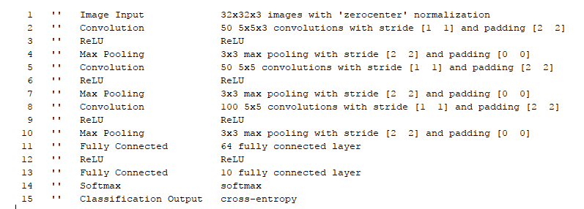
NETWORK OVERVIEW

Slide 14
EXPERIMENTS WITH FILTER SIZE
FILTER SIZE | ACCURACY SCORE
3 x 3 | 64.35%
5 x 5 | 74.25%
6 x 6 | 74.06%

Slide 15
EXPERIMENT WITH NUMBER OF FILTERS
Number of Filters | Accuracy
25 | 73.76%
32 | 74.74%
40 | 76.24%
50 | 76.54%

Slide 16
RESULTS
Traffic light object detection: 89.33% detection rate
400 training images
Illumination variation
Scale variation
Motion-blur
Intra-class variation

Slide 17
CONFUSION MATRIX
n = 600 | Positive Outcome | Negative Outcome
Real Positive | 526 (87.67%) (true positive) | 64 (10.67%) (false negative)
Real Negative | 0 (0%) (false positive) | 10 (1.67%) (true negative)

Slide 18
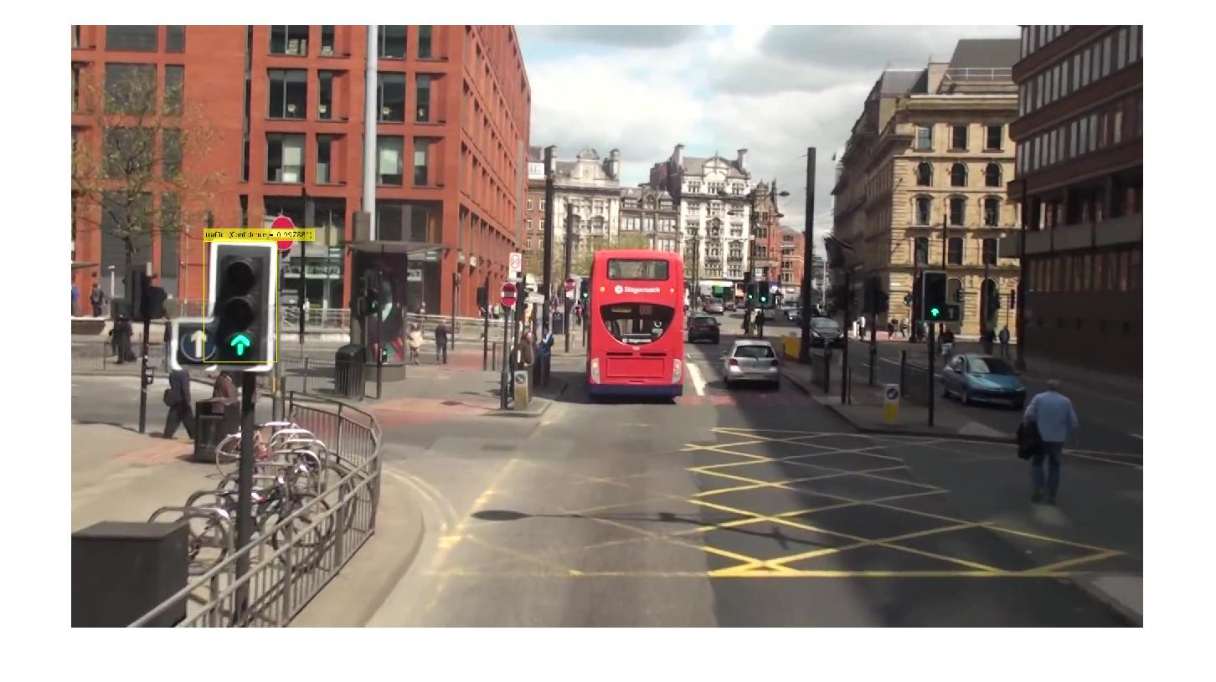
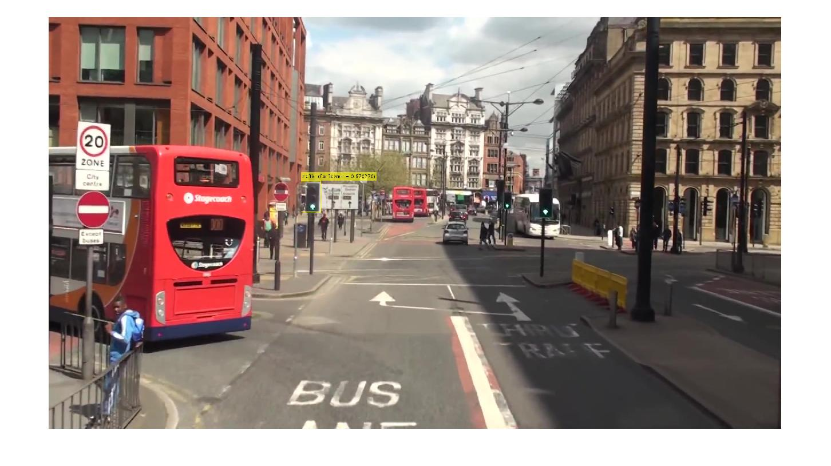
GREEN TRAFFIC LIGHT DETECTION

Slide 19
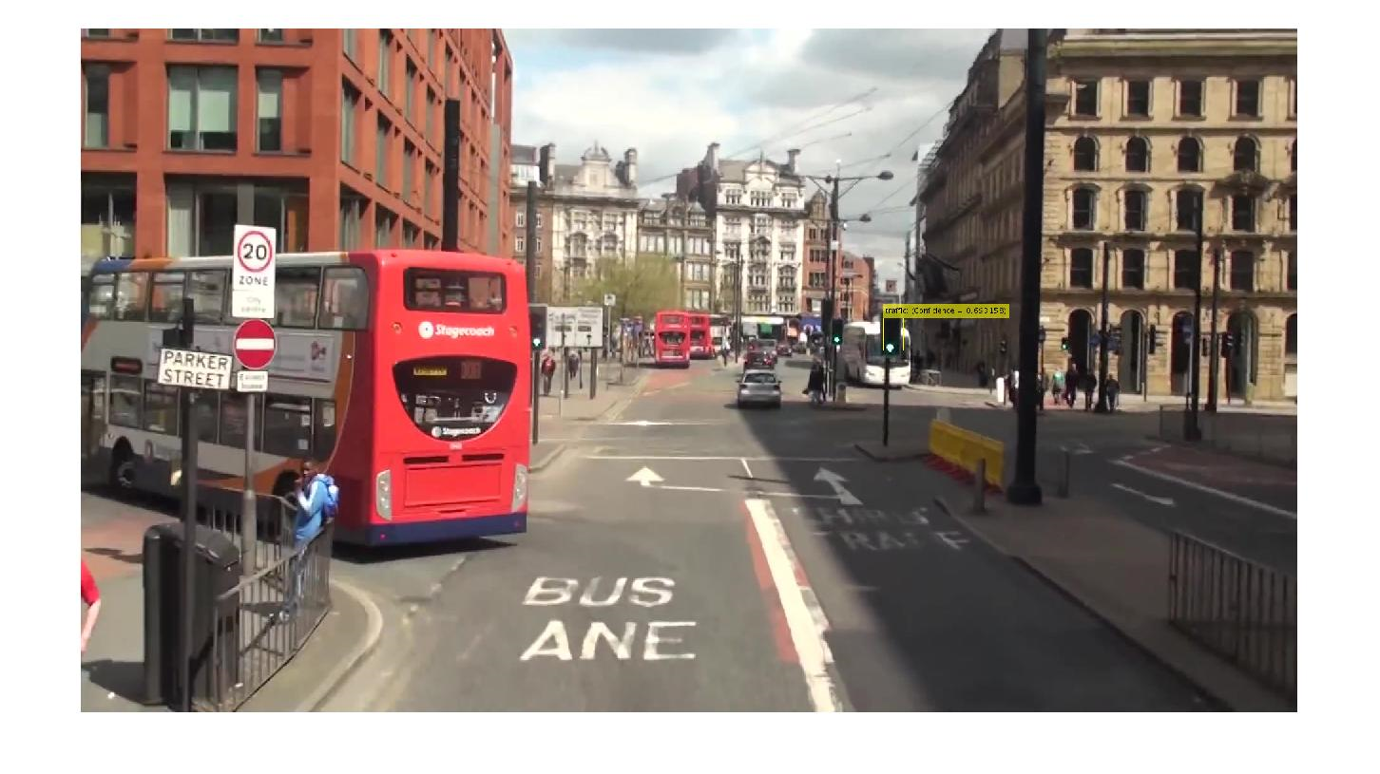
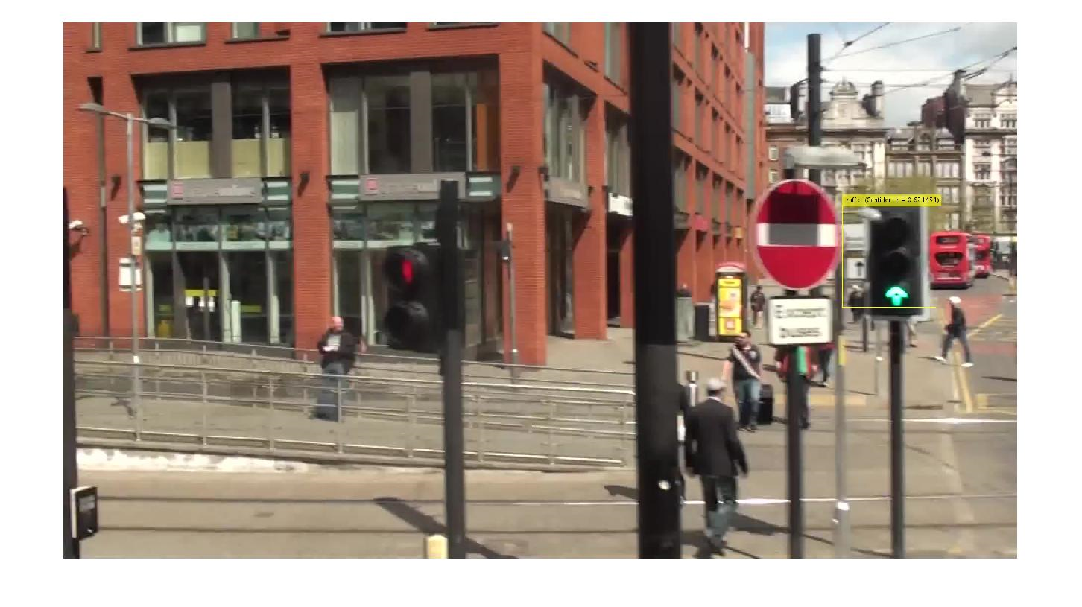
GREEN TRAFFIC LIGHT DETECTION

Slide 20
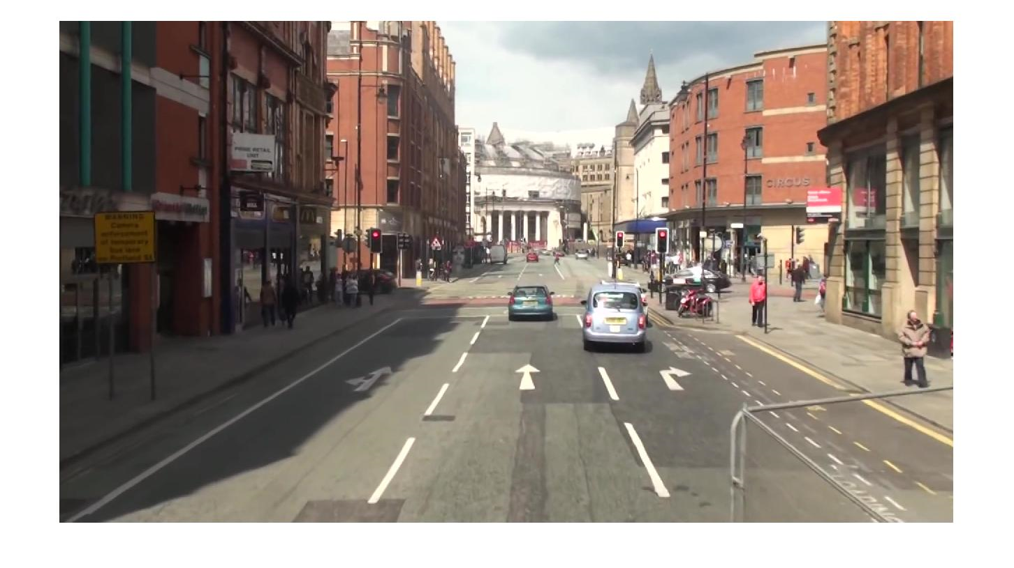
GREEN TRAFFIC LIGHT DETECTION

Slide 22
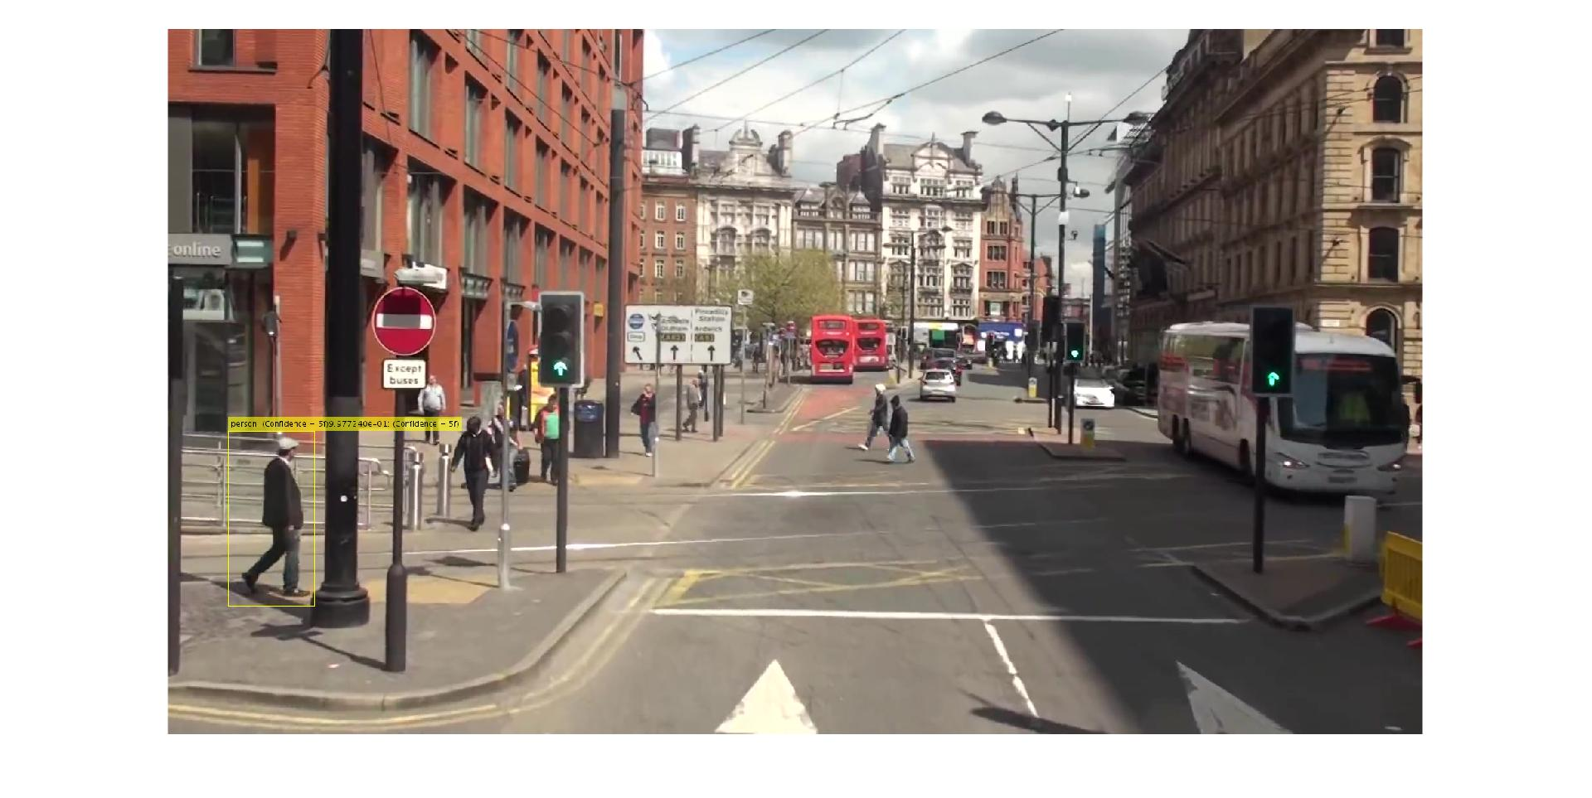
RESULT WITH PEOPLE

Slide 23
CHALLENGES
For a single scene there is a lack of diverse training samples on our dataset
People varied too much per training set
Pose variations
People in close quarters (i.e. shaking hands, hugging, etc.)
People carrying objects with them

Slide 24
FUTURE WORK
Train network with a more robust dataset to achieve better performance
Expand to include ability for multiple object detection
More robust to occlusions and other challenges faced by object detection

Slide 25
REFERENCES
https://motchallenge.net/data/MOT16/
https://www.mathworks.com/help/vision/ref/rcnnobjectdetector-class.html
https://www.cs.toronto.edu/~kriz/cifar.html

Slide 26
THE END

